Slide 1
Parallel and Distributed Simulation
Process Oriented Simulation

Slide 2
Outline
A Simple DES Example (Review)
Parallel and Distributed Simulation
Process-oriented simulation
Fundamental concepts: Processes, resources
Simulation primitives
Example
Implementation

Slide 3
A Simple DES Example
H0
H1
Time | Event
0 | H0 Send Pkt
100 | Done
Time | Event
1 | H1 Recv Pkt
6 | H0 Retrans
100 | Done
Time | Event
1 | H1 Send Ack
6 | H0 Retrans
100 | Done
Time | Event
2 | H0 Recv Ack
6 | H0 Retrans
100 | Done
Time | Event
2 | H0 Send Pkt
100 | Done
Simulator maintains event list
Events processed in simulation time order
Processing events may generate new events
Complete when event list is empty (or some other termination
condition)

Slide 4

Parallel and Distributed Simulation
simulation model
Parallel simulation involves the
execution of a single simulation program on a collection
of tightly
a shared
coupled memory
processors (e.g.,
multiprocessor).
P
P
P
P
Parallel processor
M M M
Distributed simulation involves
Replicated trials involves the
execution of several, independent
the execution of a single simulation program on a collection of loosely
simulations concurrently on different processors
coupled processors (e.g., PCs
interconnected by a LAN or WAN).

Slide 5
Process Oriented Simulation
Focus simulation program around behavior of entities
Aircraft: arrives, waits for runway, lands, departs.
Process-oriented simulation
Process: thread of execution describing entity behavior over time
Resources: shared resource used by entities (e.g., runway)
Execution: alternate between simulation computations at a single instant of simulation time, and advanced in simulation time (no computation).
Computation at a single Instant of simulation time
Simulation time advances (no computation)
Computation | Time advance | Computation | Time advance
Wall clock time
A thread is the smallest unit of processing that can be performed in an OS.
A thread exists within a process - that is, a single process may contain multiple
threads.

Slide 6
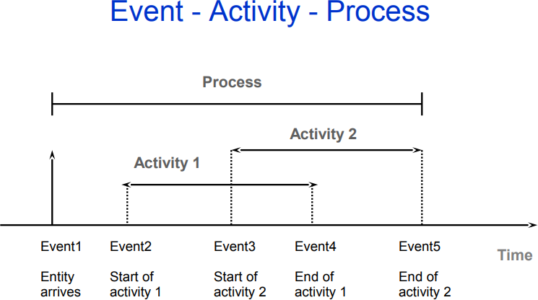
Process-oriented simulation is a type of simulation that allows related state changes to be combined in the context of a process.
It is based on viewing the simulation in terms of the experience of entities that flow through the system.

Slide 7
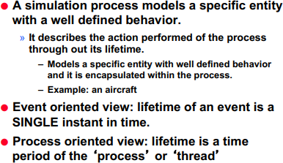
Process Oriented Cont’

Slide 8
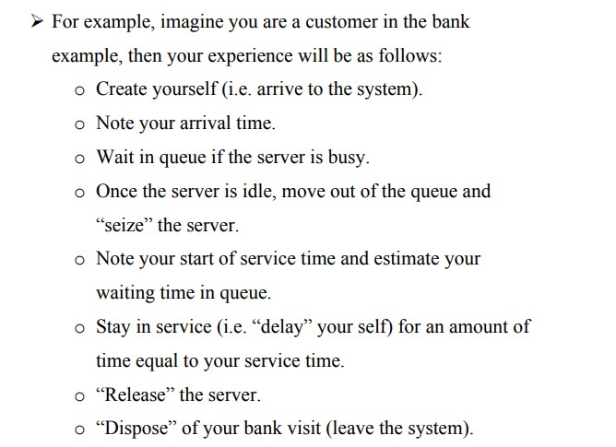

Slide 9
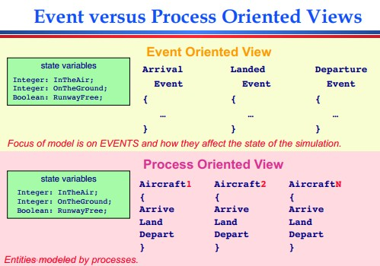

Slide 10
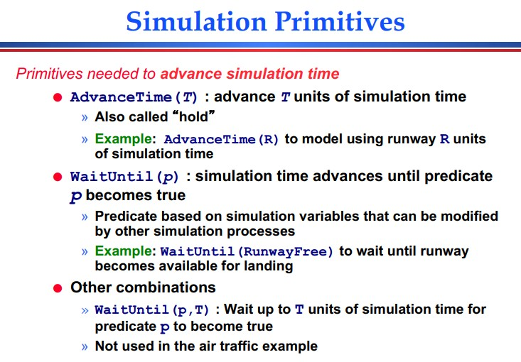

Slide 11
Implementation
Process-oriented simulations are built over event oriented simulation mechanisms (event list, event processing loop)
Lifetime of a simulation process consists of a
sequence of event computations
Event computation: computation occurring at an instant in simulation time
Execution of code section ending with calling a primitive to advance simulation time
Computation threads
– Typically implemented with co-routine (threading) mechanism
Simulation primitives to advance time
Schedule events
Event handlers resume execution of processes

Slide 12
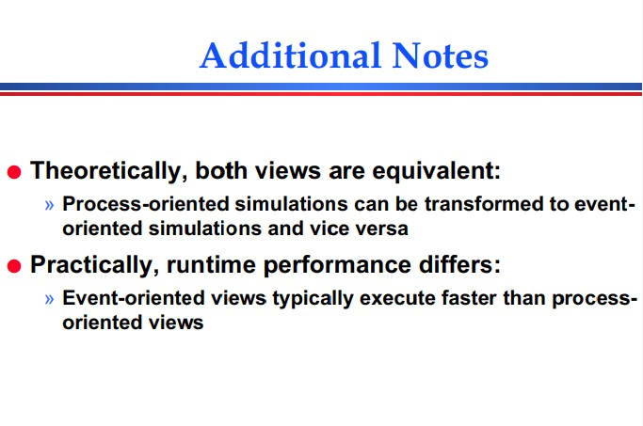

Slide 13
Summary
Process-oriented simulation typically simplified model development and modification
Requires threading (e.g., co-routine) mechanism
Additional complexity and computation overhead to suspend and resume simulation processes

Slide 14
QUEUING (WAITING LINE) THEORY

Slide 15
1. Introduction
On a daily basis, we all have to wait on some queue (waiting line).
Examples:
At fuel filling station
At the bank
At the post office
At the traffic lights
At the garage
To get a cup of tea at a restaurant.

Slide 16
2. HISTORY
In 1909, A.K. Erlang analysed telephone traffic congestion in the Copenhagen Telephone system.
His objective was to determine how to meet uncertain demand for services. The study gave birth to Queuing or Waiting line theory.
This theory is now a valuable tool in business systems study because many business system problems can be characterised as arrival-departure congestion problems.

Slide 17
Overview of queuing systems
Queuing theory deals with all aspects of situations in which customers must wait for a given service.
Waiting lines (queues) are part of everyone’s daily life.
Examples of waiting lines are customers wait for a service, jobs wait to be processed, vehicles waiting at the traffic lights, planes wait to land.

Slide 18

Departure of served customers
Customer arrivals
Departure of impatient customers
The term "customer" can be men, products, machines, ...
18

Slide 19
Overview cont..
Waiting lines (queues) are formed when the current demand for a given service exceeds the capacity to provide the service.
In most cases additional service facilities could be provided to decrease queue or to prevent queues from forming; however the cost to provide the additional service may cause the margin of profit to drop below acceptable levels.

Slide 20
Overview cont..
On arrival at a facility customers can be serviced immediately or wait in queue when the service is occupied; when the facility completes the service it automatically pulls a waiting customer if any from the queue.
If the queue is empty, the facility becomes idle until the new customer arrives.

Slide 21
Classification characteristics of queuing system
There are so many types of queuing systems but all can be classified according to the following characteristics:
Input process;
Service process;
and Queue discipline.

Slide 22
Classification characteristics cont..
Input or arrival process
This includes the distribution of the number of arrivals per unit of time, the number of queues that are permitted to form, the maximum queue length and the number of customers desiring the service.

Slide 23
Classification characteristics cont..
Service process
This includes the distribution of the time to service customers, the number of servers (facilities) and the arrangement of servers (the arrangement may be in parallel or in series).

Slide 24
Classification characteristics cont..
Queue discipline
This represents the manner or order in which customers are selected from the queue.
E.g first come, first serve (FCFS) or first in first out (FIFO)
Last come first served (LCFS) or last in first out (LIFO)
Service in random order or (SIRO)
Priority selection such as emergency services in hospitals, rush jobs are processed ahead of regular jobs.

Slide 25
Queuing system
A queuing system involves customers arriving at the
service facility (server).
Customers are generated from a source; this source can be finite or infinite.
A finite source e.g. ATM machines for a given bank that require to be serviced.
An infinite source is forever abundant e.g. calls arriving at
a telephone exchange.

Slide 26
3. DEFINITION
A QUEUING PROCESS consists of customers arriving at a service facility; then waiting in a line (queue) if all services are busy; eventually receiving service; and finally departing from the facility.
A QUEUING SYSTEM comprises:
A set of customers
A set of servers, and
An order whereby customers arrive and are processed.

Slide 27
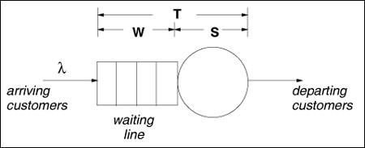
3. DEFINITION Cont….
Examples of QUEUING SYSTEMS:
Single queue, single server system
It can laso be called “G/G/1” queue.
The first "G" indicates that the distribution of interarrival times of customers arriving to the system can be any generic distribution.
The second "G" indicates that the service time distribution of the single server is also generic.
The "1" indicates that there is a single server.

Slide 28
Customers arrive, join a waiting line if the server is not idle, wait their turn to use the server according to a FCFS queuing discipline, and depart after having received service.
The average arrival rate of customers is denoted by l, the average time spent waiting in the queue is denoted by W, the average service is denoted by E[S], and the response time (i.e., the sum of the average waiting time plus the average service time) is denoted by T. Then,
Fall 2007 SCM
28

Slide 29
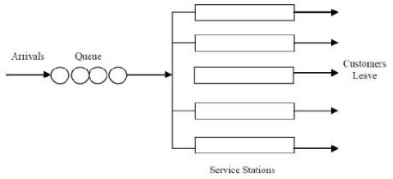
Single queue, multiple servers in parallel
Fall 2007 SCM
30

Slide 30
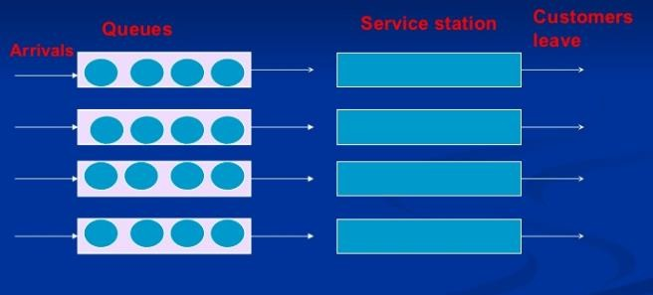
Multiple queues, multiple servers in parallel
31

